Slide 1
Battle of the neighborhoods
Brandon Truong

Slide 2
Background
Cities aren’t usually carbon copies of each other, as their venues and location contribute to each of their unique culture
However, they can be like other cities through their venues
Convenient for people who:
Move to another city
Intend on living somewhere similar to where they were

Slide 3
Data acquisition and cleaning
Neighborhoods and geographic location in New York, obtained from https://cocl.us/new_york_dataset
Neighborhoods and geographic location in Toronto, 2008 scraped from https://en.wikipedia.org/w/index.php?title=List_of_postal_codes_of_Canada:_M&oldid=945633050.
Data cleaned to obtain the following features:
New York: borough, neighborhood, latitude, longitude
Toronto: postcode, borough, neighborhood
Values not assigned under the “borough” column were replaced with values under “neighborhood” column
Foursquare API was used to obtain common venue information between the cities

Slide 4
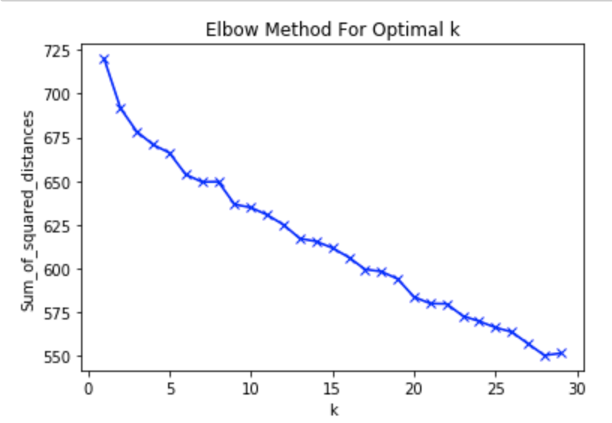
Using elbow method to find optimal cluster number
No distinct “elbow”
15 clusters would be a reasonable choice

Slide 5
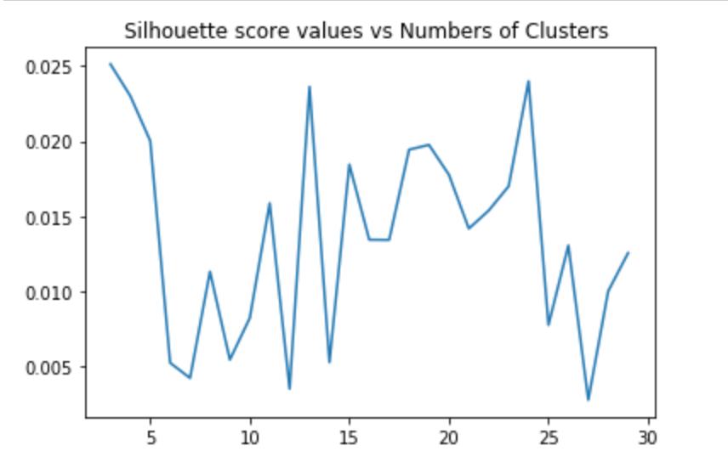
Silhouette score analysis
Number of clusters being 5 has its peak
Silhouette Coefficient found using mean intra-cluster distance and mean nearest-cluster distance

Slide 6
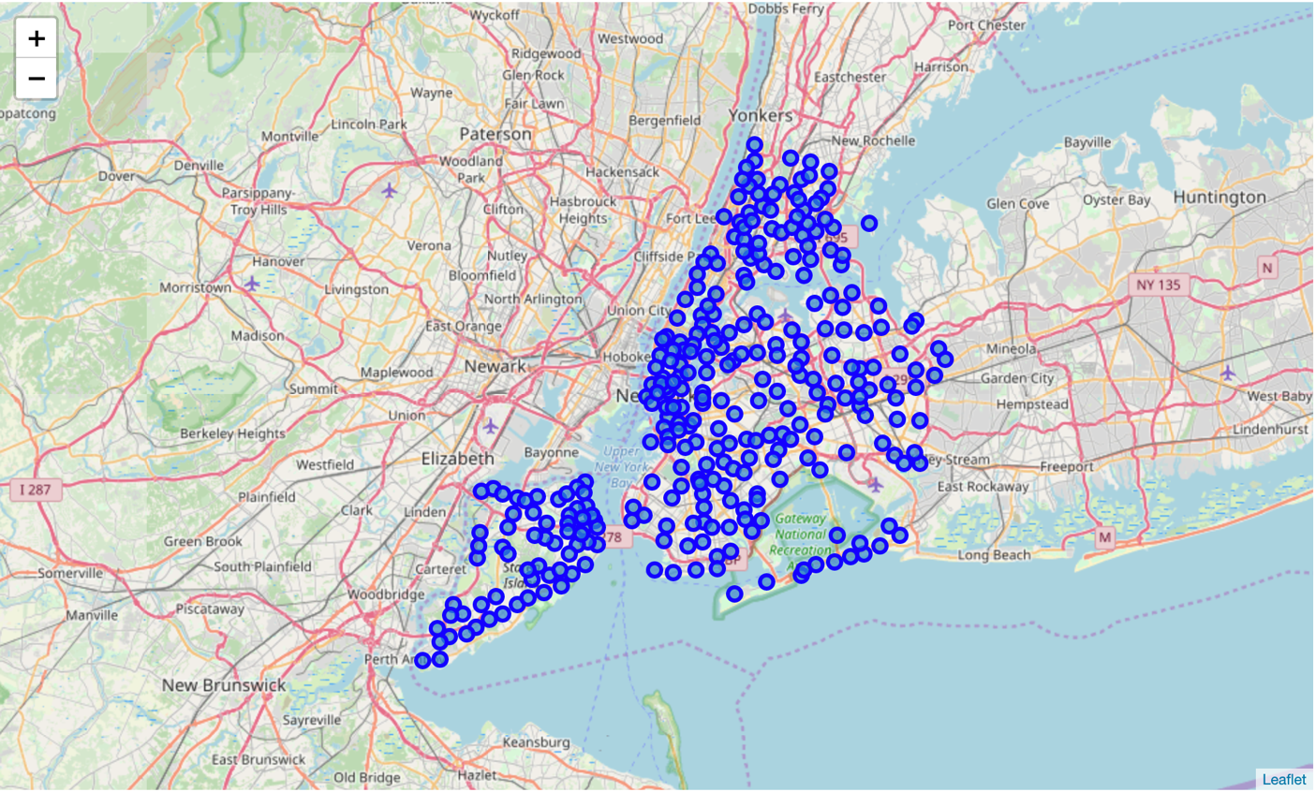
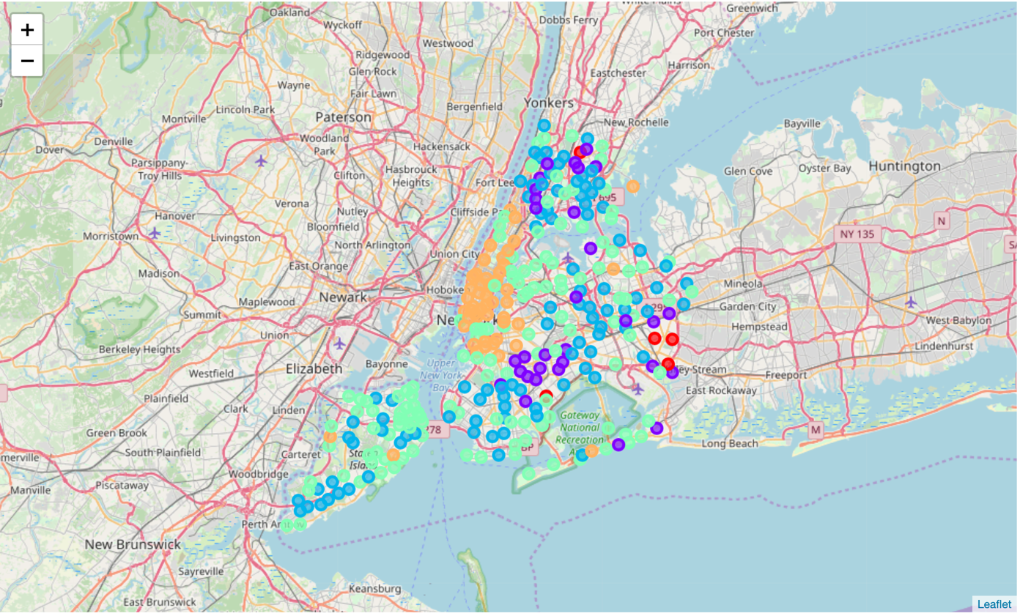
New York

Slide 7
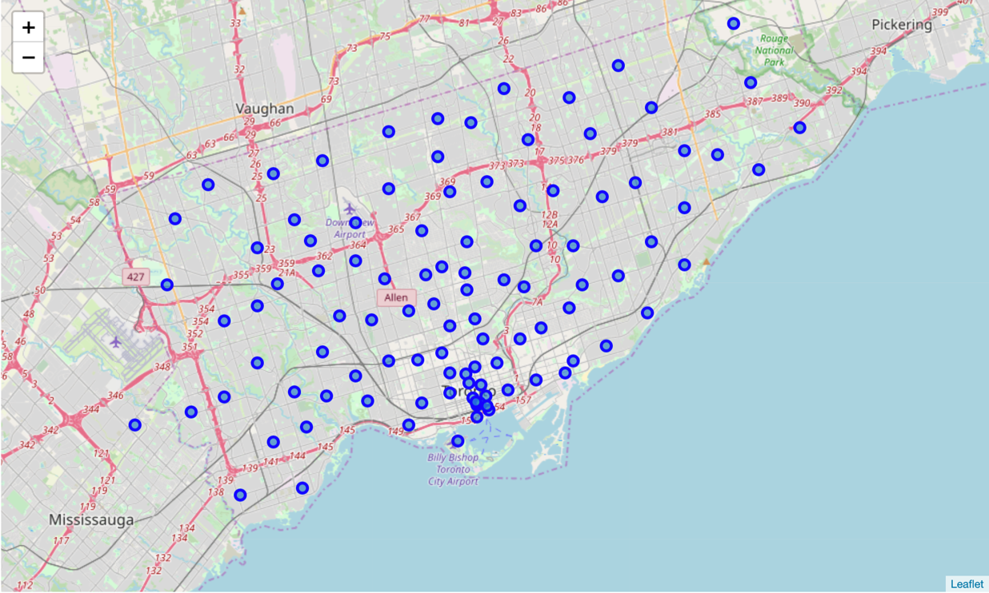
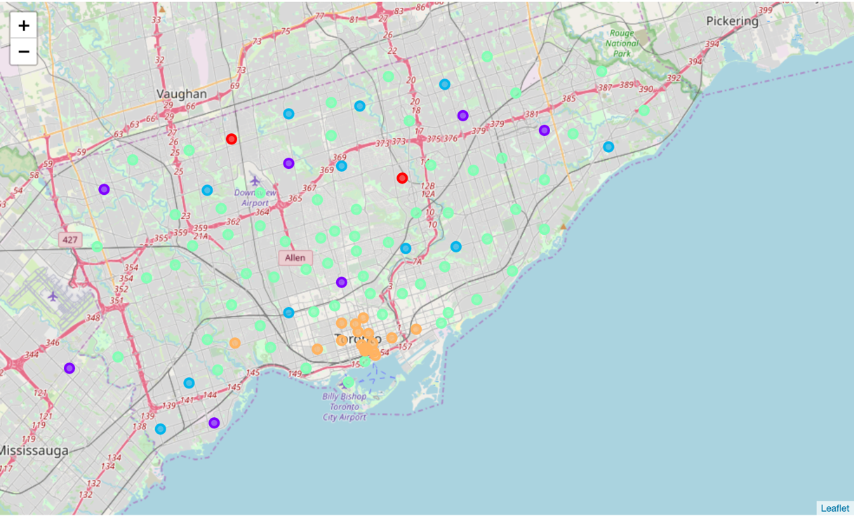
Toronto
Similar areas found between New York and Toronto

Slide 8
Conclusion and future application
Built a recommendation system for people who are moving to a new area that is like their previous location
Different approaches could produce better results
Utilize more features
Look at geographical location at neighborhood level
Possible applications:
City resources
Crime data
Demographics

